Slide 1

Neural Substrates of Attention and Awareness
Dan Birman
Gardner Lab
Frisem – 2015-04-17

Slide 4


Slide 5


Slide 8


Slide 10
Attention as a Pre-Requisite to Awareness
Dual task designs “pull” attention to one task, causing inattentional blindness for other stimuli.
“we believe […] there is no conscious perception without attention” (Mack & Rock, 1998)

Slide 11
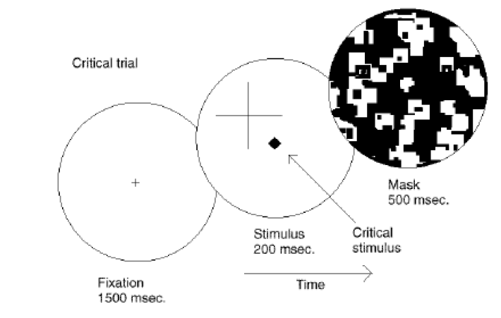
Attention as a Pre-Requisite to Awareness
Dual task designs “pull” attention to one task, causing inattentional blindness for other stimuli.
“we believe […] there is no conscious perception without attention” (Mack & Rock, 1998)
Mack & Rock, 1998
Notes:
There is one situation where attention (seems) to not be a pre-requisite for awareness

Slide 12
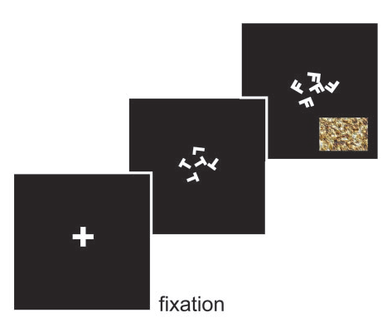
Gist Perception
“The close relationship between attention and
consciousness has led many scholars to conflate these processes“ (Koch & Tsuchiya, 2006)
Li et al., 2002

Slide 13
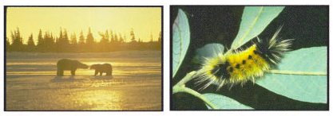
Gist Perception
“The close relationship between attention and
consciousness has led many scholars to conflate these processes“ (Koch & Tsuchiya, 2006)
Li et al., 2002

Slide 14
A Possible Solution: What does attention affect?
If attention to a fixation cross affects a certain set of neurons, that doesn’t immediately imply any specific changes among other neurons.
How does attention feed forward into awareness? – Likely that feed forward occurs in the absence of attention only due to expertise
We need models and we need to test where attention acts, and where awareness is read-out of representations.

Slide 15
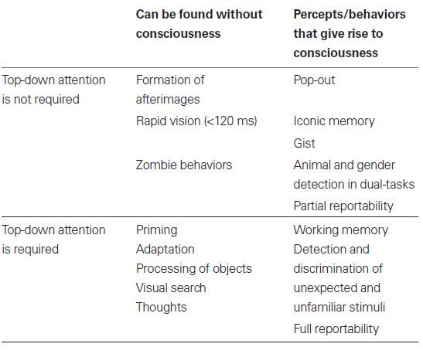
Van Boxtel, Jeroen J a, Naotsugu Tsuchiya, and Christof Koch. “Consciousness and Attention: On Sufficiency and Necessity.” Frontiers in Psychology 1, no. December (January 2010): 217–217. doi:10.3389/fpsyg.2010.00217.

Slide 16
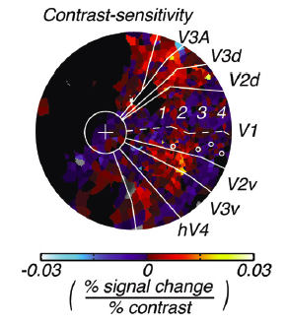

Conceptual Overview: Task Design
Where are the representations for different properties of stimuli held in the brain?
What are the neural effects of pushing attention to a specific location or feature?
How can we measure awareness while manipulating attention?
Notes:
First attempt: dual

Slide 17
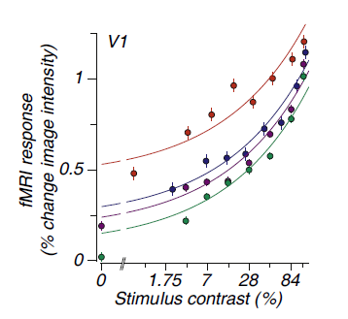
Identifying Neural Substrates
BOLD Magnitude
Pestilli et al., 2011

Slide 18
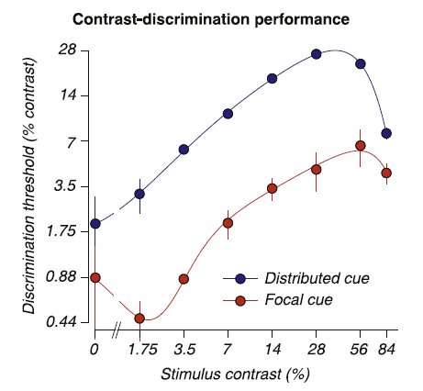
Identifying Neural Substrates
BOLD Magnitude
Pestilli et al., 2011

Slide 19
Identifying Neural Substrates
Behavioral Performance ←→ BOLD Magnitude
Pestilli et al., 2011

Slide 20
Conceptual Overview: Attention & Awareness
“Recent research has slowly corroded a belief that selective attention and consciousness are so tightly entangled that they cannot be individually examined.” (van Boxtel et al. 2010)
Attention: Local feature-specific modulation of neural activity
Awareness: A downstream process, dependent in an uncertain manner on attention.
If attention and awareness are dissociable, their models should implement different computations.
Notes:
First attempt: dual

Slide 21
Conceptual Overview: Task Design
Where are the representations for different properties of stimuli held in the brain?
Notes:
First attempt: dual

Slide 22
Conceptual Overview: Task Design
Where are the representations for different properties of stimuli held in the brain?
Hara et al., 2014
Tjan et al., 2006
Notes:
First attempt: dual

Slide 23
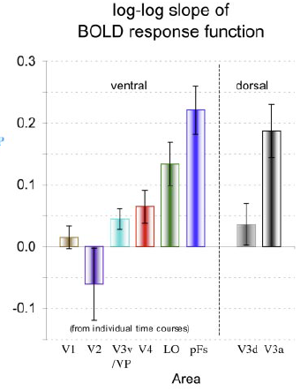
Conceptual Overview: Task Design
Where are the representations for different properties of stimuli held in the brain?
to objects
in noise
Hara et al., 2014
Tjan et al., 2006
Notes:
First attempt: dual

Slide 24
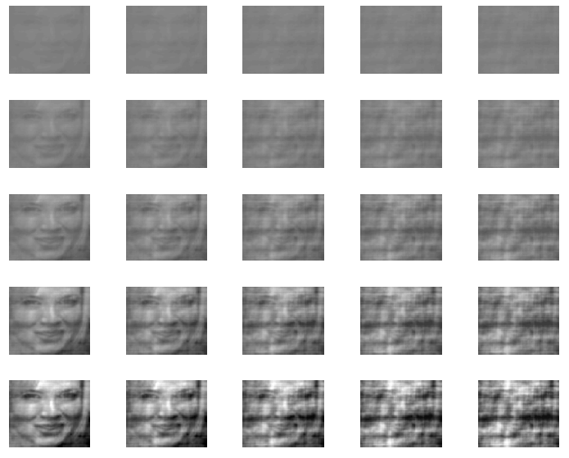
Contrast
Noise

Slide 25


Conceptual Overview: Task Design
Where are the representations for different properties of stimuli held in the brain?
What are the neural effects of pushing attention to a specific location or feature?
Notes:
First attempt: dual

Slide 26
Conceptual Overview: Task Design
Where are the representations for different properties of stimuli held in the brain?
What are the neural effects of pushing attention to a specific location or feature?
Notes:
First attempt: dual

Slide 27
(2) Selective vs. Spatial Attention
Noise Block
Contrast Block
Feature Attention: Attend to either changes in noise or changes in contrast

Slide 28
(2) Selective vs. Spatial Attention
Noise Block
Contrast Block
Spatial Attention
Focal Spatial Cue
Distributed Spatial Cue

Slide 29


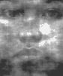

(2) Selective vs. Spatial Attention
Noise Block
Contrast Block
Fixation ITI
Cue
Stimulus
Response

Slide 30
Conceptual Overview: Task Design
Where are the representations for different properties of stimuli held in the brain?
What are the neural effects of pushing attention to a specific location or feature?
How can we measure awareness while manipulating attention?
Notes:
First attempt: dual

Slide 31
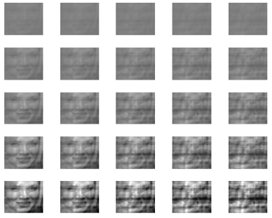
Conceptual Overview: Task Design
What the properties of stimuli represented in different brain areas?
What are the effects of pushing attention to a specific location or feature?
How can we measure awareness while manipulating attention?
Notes:
First attempt: dual

Slide 32




Overall Task Timing
Fixation ITI: 1s
1 Block = 72 trials, ~6s per trial
Cue: 1s
Stimulus 1: .6s
Peripheral Response: .8s
Stimulus 2: .6s
Per Response: .8s
Main Response: 1.2s

Slide 33



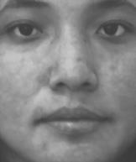
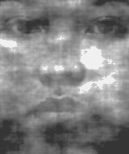


Notes:
High (dual) vs. Low (single) task conditions. Expectation: During dual task contrast/gender will have better performance than noise/gender, because noise attention is more feature-based than contrast which is more spatial.

Slide 34
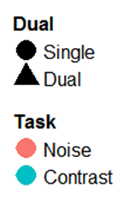
Conceptual Overview: Expectations
100%
Awareness Task Performance
Attention Task Performance
100%
Notes:
First attempt: dual

Slide 35
Conceptual Overview: Expectations
100%
Awareness Task Performance
Attention Task Performance
100%
Notes:
First attempt: dual

Slide 36
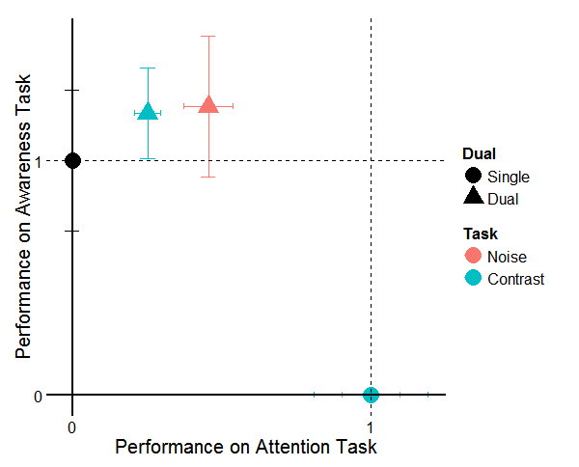
Conceptual Overview: Expectations
Notes:
First attempt: dual

Slide 37
Conceptual Overview: Expectations
Notes:
First attempt: dual

Slide 38
Attention * Awareness
There was an interaction between feature attention and awareness—but in an unexpected direction.
Is awareness of gender really a matter of “awareness”? Evidence that reading, arithmetic, priming, etc…, can be done “blind” to some extent.
Strong bottom-up attentional effects. Attention is “drawn” towards the peripheral faces.
Timing is an issue: Relative response positions cause one task to be prioritized.
Dual tasks are hard. Long training required.
Naccache et al. 2002; Sklar et al. 2012

Slide 39
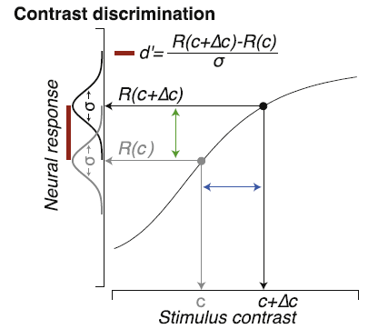
Identifying Neural Substrates
Pestilli et al., 2011

Slide 40



Gardner Lab @ Stanford University
Steeve Laquitaine
Justin Gardner
Thanks for your attention and awareness!

